Slide 1

CYCLOPS​
RESTAURANT CUSTOMER TRACKER​
Group 2332​
21902348 – Kaan Kurçer​
21902903 – Osman Serhat Yılmaz​
21903213 – Ali Doğaç Urkaya​
21902358 – Özgür Abi​
21902035 – Jankat Berslan Dinçer

Slide 2
Overview
Restaurants are visited by hundreds of unique customers with different spending habits, visiting times, and preferences every day.
Most restaurants are unable to collect and utilize the data produced by
their customers.
The information could be used to enhance both the
user experience and the profits of owners.

Slide 3
Goals
Features
Collect customer data from preexisting security cameras.
Utilize the data the gather information about the restaurant.
Allow restaurant owners to provide personalized
experiences for their customers
and increase profits.
Human Counting System
Repeat Customer Recognition
Restaurant Traffic Data
Customer & Order History

Slide 4
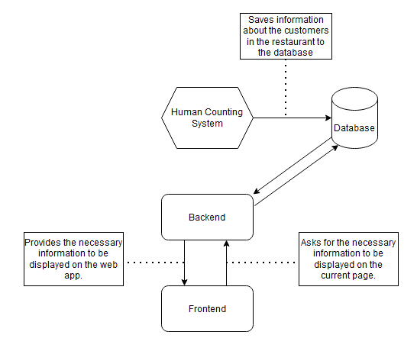
Structure of Cyclops

Slide 5
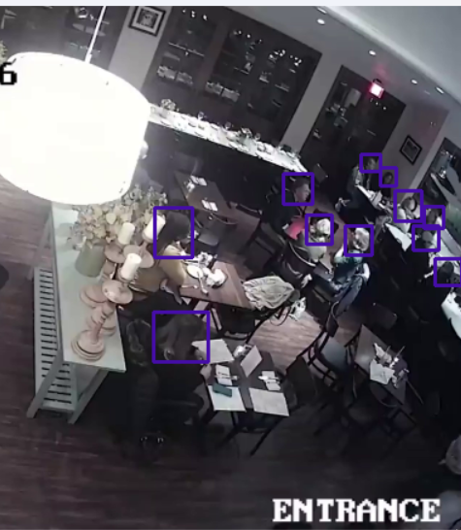
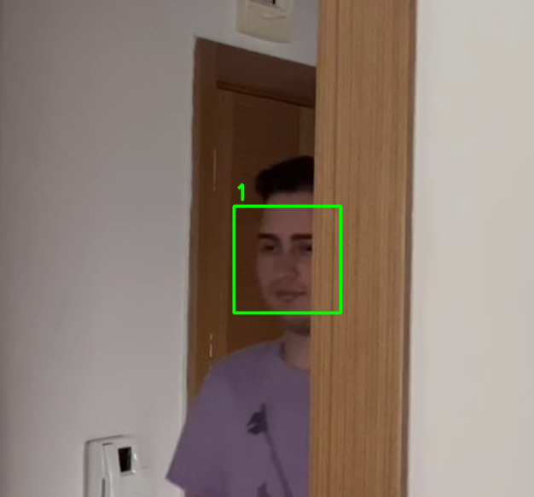
Human Detection &
Face Recognition
Human Detection: Detect people in restaurant through security camera footage.
Face Recognition: Detect and recognize faces of customers, create new profiles for new customers if needed.

Slide 6
ONTO THE DEMO

